Slide 1
CSCI-351 Data communication and Networks
Lecture 14: Content Delivery Networks
(Over 1 billion served … each day)
The slide is built with the help of Prof. Alan Mislove, Christo Wilson, and David Choffnes's class

Slide 2
Announcement (1)
To ask for regrading, you must come to office hours (or send me an email for scheduling) with the following in writing:
Specify the problem(s) you want regraded
For each problem, explain why the grade is in error

Slide 3
Announcement (2)
Project 3 will be announced today
Make your team early (until 11/13)
HTTP Crawling
One of the essential skills for your future career
Data-mining, Visualization, Analysis, etc.
You will be required to construct a simple database
Will be relatively easy, thus it doesn’t require milestone submission
Score of Project 2 will be announced at the next class (sorry for the delay)
Notes:
http://www.wikicfp.com/cfp/data.jsp

Slide 4
Announcement (3)
Project 4 is about security stuff
DNS + Security

Slide 5
Outline
Motivation
CDN basics
Prominent example: Akamai
Notes:
Never go under

Slide 6
Content in today’s Internet
Most flows are HTTP….
Web is at least 52% of traffic (as of early 2000), however..
HTTP uses TCP, so it will
Be ACK clocked
For Web, likely never leave slow start
QUIC?
Is the Internet designed for this common case?
Why?

Slide 7
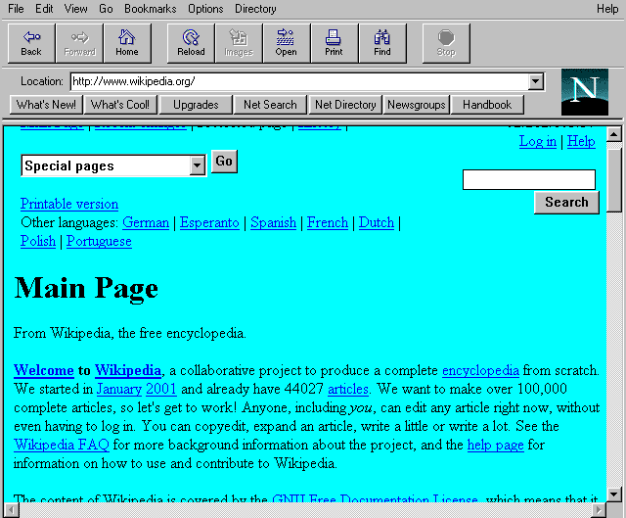
Evolution of Serving Web Content
In the beginning…
…there was a single server
Probably located in a closet
And it probably served blinking text
Issues with this model
Site reliability
Unplugging cable, hardware failure, natural disaster
Scalability
Flash crowds (aka Slashdotting)

Slide 8
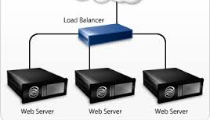
Replicated Web service
Use multiple servers
Advantages
Better scalability
Better reliability
Disadvantages
How do you decide which server to use?
How to do synchronize state among servers?

Slide 9
Load Balancers
Device that multiplexes requests across a collection of servers
All servers share one public IP
Balancer transparently directs requests to different servers
How should the balancer assign clients to servers?
Random / round-robin
When is this a good idea?
Load-based
When might this fail?
Challenges
Scalability (must support traffic for n hosts)
State (must keep track of previous decisions)

Slide 10
Load balancing: Are we done?
Advantages
Allows scaling of hardware independent of IPs
Relatively easy to maintain
Disadvantages
Expensive
Still a single point of failure
Location!
Where do we place the load balancer for Wikipedia?

Slide 11
Popping up: HTTP performance
For Web pages
RTT matters most
Where should the server go?
For video
Available bandwidth matters most
Where should the server go?
Is there one location that is best for everyone?

Slide 12

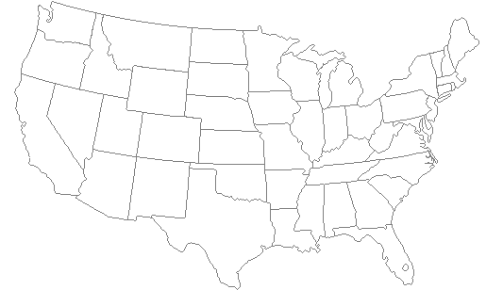
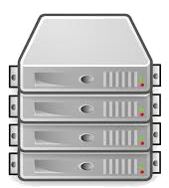
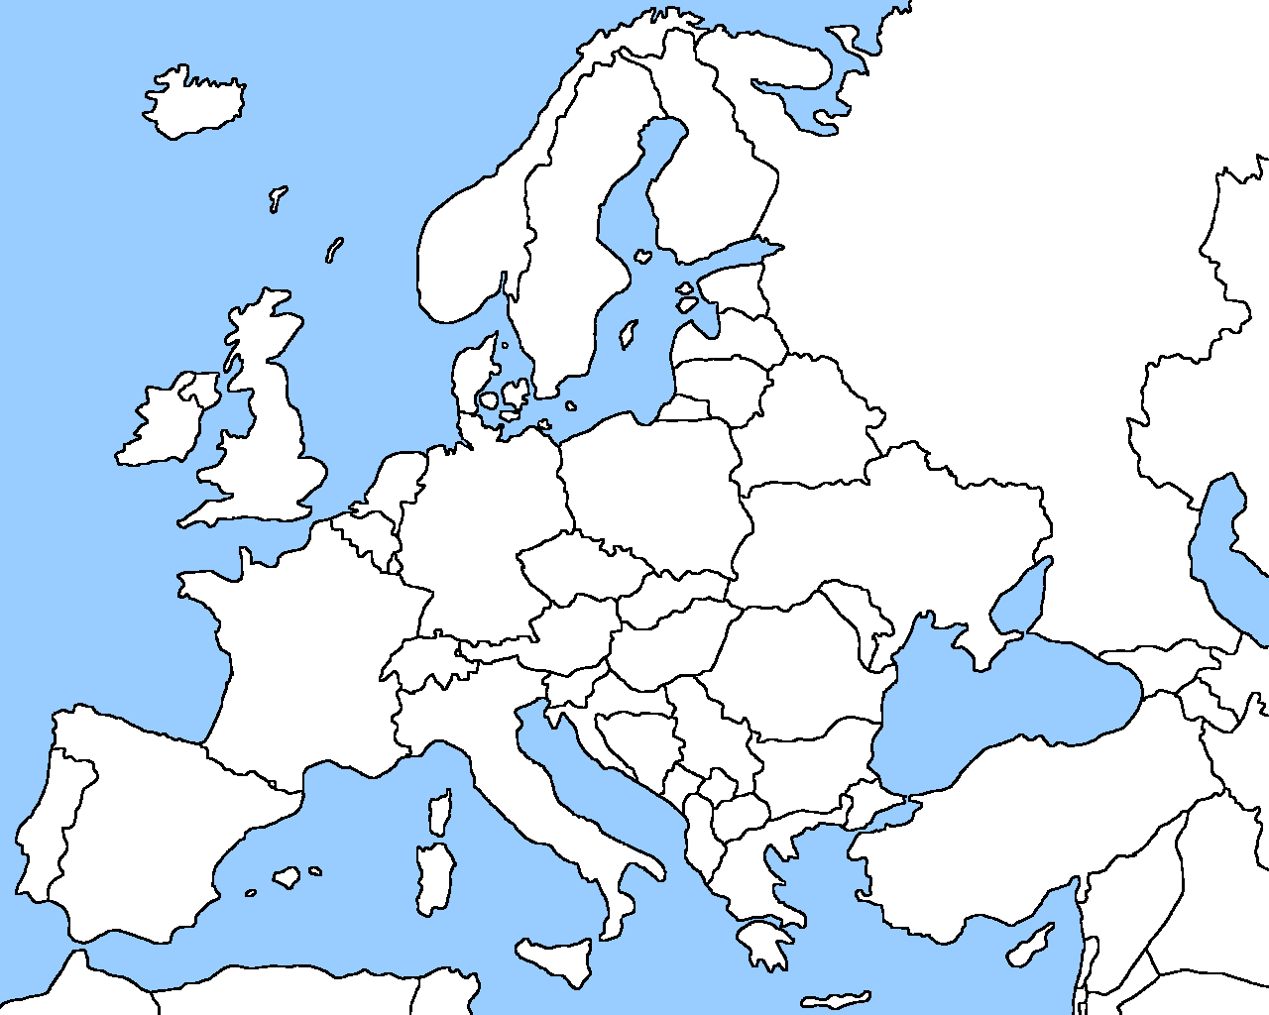
Server placement

Slide 13
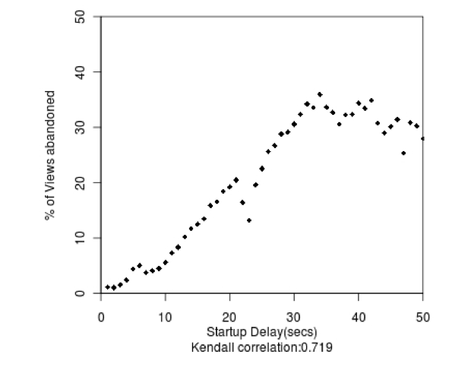
Why speed matters
Impact on user experience
Users navigating away from pages
Video startup delay

Slide 14

Why speed matters
Impact on user experience
Users navigating away from pages
Video startup delay
Impact on revenue
Amazon: increased revenue 1% for every 100ms reduction in PLT*
Ping from ROC to LAX: ~100ms
Notes:
Demystifying Page Load Performance with WProf - Computer Science ...
https://homes.cs.washington.edu/~arvind/papers/wprof.pdf

Slide 15
Strawman solution: Web caches
ISP uses a middlebox that caches Web content
Better performance – content is closer to users
Lower cost – content traverses network boundary once
Does this solve the problem?
No!
Size of all Web content is too large
Zipf distribution limits cache hit rate
Web content is dynamic and customized
Can’t cache banking content
What does it mean to cache search results?
Notes:
Zipf’s law: the frequency of an item is inversely proportional to its rank in a frequency table.

Slide 16
Outline
Motivation
CDN basics
Prominent example: Akamai

Slide 17
What is a CDN?
Content Delivery Network
Also sometimes called Content Distribution Network
At least half of the world’s bits are delivered by a CDN
Probably closer to 80/90%
Primary Goals
Create replicas of content throughout the Internet
Ensure that replicas are always available
Directly clients to replicas that will give good performance

Slide 18
Key Components of a CDN
Distributed servers
Usually located inside of other ISPs
Why?
High-speed network connecting them
Clients
Can be located anywhere in the world
They want fast Web performance
Glue
Something that binds clients to “nearby” replica servers

Slide 19

Key CDN Components
16

Slide 20
Examples of CDNs
Akamai
147K+ servers, 1200+ networks, 92 countries (in early 2010)
240K+ servers, 1700+ networks, 130 countries (now)
Cloudflare, Limelight, Edgecast, and others web service providers (e.g., Google, Facebook)
Advice…?

Slide 21
Inside a CDN
Servers are deployed in clusters for reliability
Some may be offline
Could be due to failure
Also could be “suspended” (e.g., to save power or for upgrade)
Could be multiple clusters per location (e.g., in multiple racks)
Server locations
Well-connected points of presence (PoPs)
Inside of ISPs

Slide 22
Mapping clients to servers (1)
CDNs need a way to send clients to the “best” server
The best server can change over time
And this depends on client location, network conditions, server load, …
What existing technology can we use for this?
URL Rewriting
Modifies the URL of specific content
netflix.com/movie1 to a17.akamai.com/movie1
Requires content modification in the origin websites
But it allows fine-grained controls

Slide 23
Mapping clients to servers (2)
DNS-based redirection (most widely used)
DNS Server approaches
Clients request www.foo.com
DNS server directs client to one or more IPs based on request IP
Use short TTL to limit the effect of caching
CNAME approaches
Clients request www.foo.com
Returned record is foo.com CNAME a18.akamai.com

Slide 24
CDN redirection example
tijay$ dig www.fox.com
;; ANSWER SECTION:
www.fox.com. 510 IN CNAME www.fox-rma.com.edgesuite.net.
www.fox-rma.com.edgesuite.net. 5139 IN CNAME a2047.w7.akamai.net.
a2047.w7.akamai.net. 4 IN A 23.62.96.128
a2047.w7.akamai.net. 4 IN A 23.62.96.144
a2047.w7.akamai.net. 4 IN A 23.62.96.193
a2047.w7.akamai.net. 4 IN A 23.62.96.162
a2047.w7.akamai.net. 4 IN A 23.62.96.185
a2047.w7.akamai.net. 4 IN A 23.62.96.154
a2047.w7.akamai.net. 4 IN A 23.62.96.169
a2047.w7.akamai.net. 4 IN A 23.62.96.152
a2047.w7.akamai.net. 4 IN A 23.62.96.186

Slide 25
DNS Redirection Considerations
Advantages
Uses existing, scalable DNS infrastructure
URLs can stay essentially the same
TTLs can control “freshness”
Limitations
DNS servers see only the DNS server IP
Assumes that client and DNS server are close. Is this accurate?
Content owner must give up control
Unicast addresses can limit reliability; the client will connect to “one” IP
Notes:
EDNS0 client subnet (Extension DNS)

Slide 26
CDN Using Anycast
Anycast address
An IP address in a prefix announced from multiple locations
120.10.0.0/16
AS 41
AS 32
AS 31
120.10.0.0/16
AS 20
AS 3
AS 1
AS 2
?

Slide 27
Anycasting Considerations
Why do anycast?
Simplifies network management
Replica servers can be in the same network domain
Uses best BGP path
Disadvantages
BGP path may not be optimal
Stateful services can be complicated

Slide 28
Optimizing Performance
Key goal Send clients to server with best end-to-end performance
Performance depends on
Server load
Content at that server
Network conditions
Optimizing for server load
Load balancing, monitoring at servers
Generally solved

Slide 29
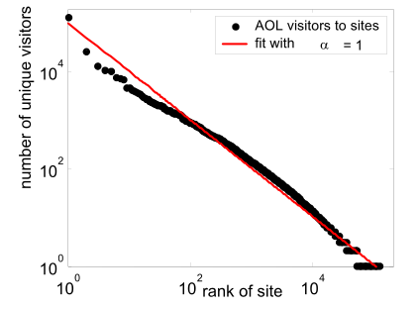
Optimizing performance: caching
Where to cache content?
Popularity of Web objects is Zipf-like
Also called heavy-tailed and power law
N_{r} ~ r⁻¹
Small number of sites cover large fraction of requests
Different popularity depending on the location
Temporal and spatial popularity
Do you think it is easy to predict?

Slide 30
Optimizing performance: Network
There are good solutions to server load and content
What about network performance?
Key challenges for network performance
Measuring paths is hard
Traceroute gives us only the forward path
Shortest path != best path
RTT estimation is hard
Variable network conditions
May not represent end-to-end performance
No access to client-perceived performance

Slide 31
Optimizing performance: Network
Example approximation strategies
Geographic mapping
Internet paths do not take shortest distance
Active measurement
Ping from all replicas to all routable prefixes
56B * 100 servers * 500k prefixes = 500+MB of traffic per round
Passive measurement
Send fraction of clients to different servers, observe performance
Downside: Some clients get bad performance

Slide 32
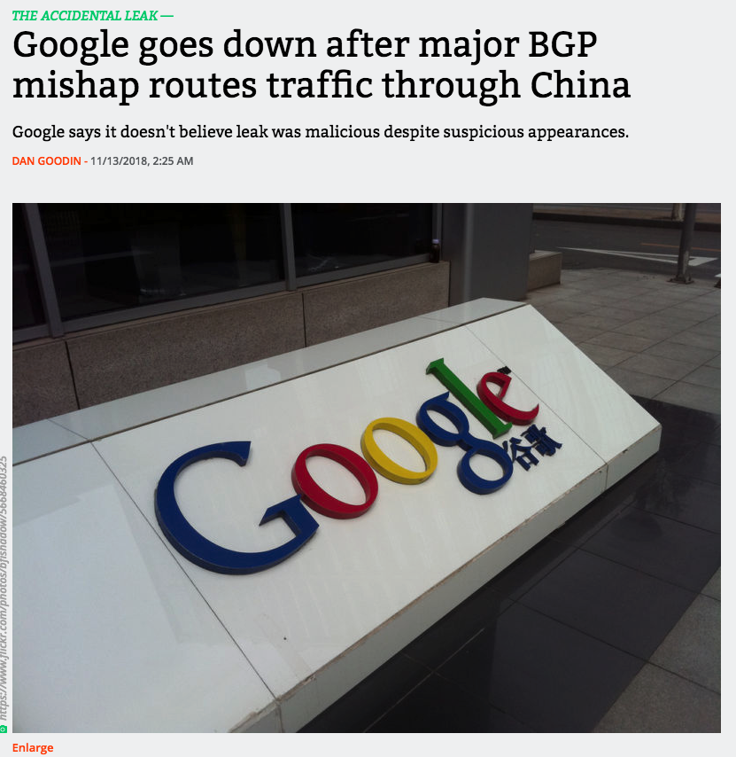

Slide 33
Announcement (1)
Project3
“SQLite3” is installed on the glados
You do not need to use virtualenv
Project4 will be announced before the project3
To give you enough time to implement

Slide 34
Announcement (2)
Student’s anonymous ID

Slide 35
Distribution — Midterm

Slide 36
Distribution — Quizzes
This can be higher depending on the result of the rest of the quizzes

Slide 37
Distributions – potential grades?
Assuming that you would get full scores for all the rest of the projects and exams
Bonus points and potential quizzes are not taken into account
A, A-
B, B-
C, C-

Slide 38
How to understand CDNs
Deploy multiple servers across the globe
How to make users connect the CDN server?
Changing all URLs of the content
DNS Authoritative server
How to find the best server?
IPs of DNS resolver
Anycast
EDNS (not covered from the class)

Slide 39
Outline
Motivation
CDN basics
Prominent example: Akamai

Slide 40
Akamai case study
Deployment
147K+ servers, 1200+ networks, 650+ cities, 92 countries
highly hierarchical, caching depends on popularity
4 yr depreciation of servers
Many servers inside ISPs, who are thrilled to have them
Deployed inside100 new networks in last few years
Customers
250K+ domains: all top 60 eCommerce sites, all top 30 M&E companies, 9 of 10 to banks, 13 of top 15 auto manufacturers
Overall stats
5+ terabits/second, 30+ million hits/second, 2+ trillion deliveries/day, 100+ PB/day, 10+ million concurrent streams
15-30% of Web traffic

Slide 41
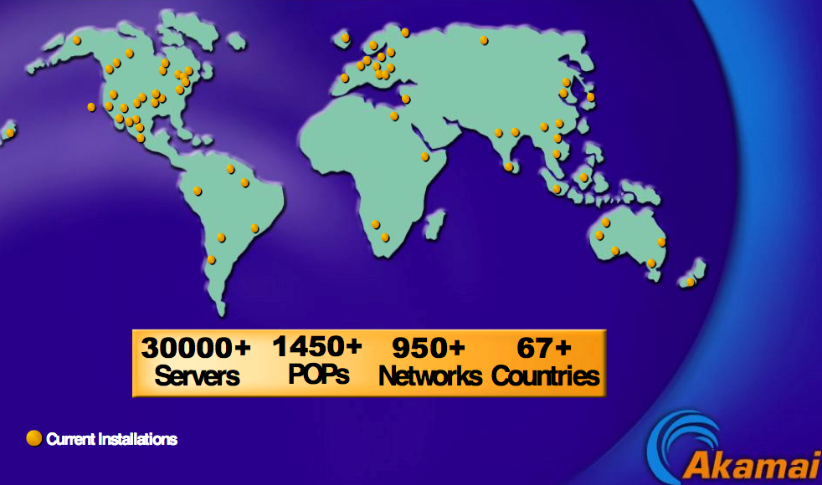
Somewhat old network map

Slide 42


DNS Redirection
Web client’s request redirected to ‘close’ by server
Client gets web site’s DNS CNAME entry with domain name in CDN network
Hierarchy of CDN’s DNS servers direct client to 2 nearby servers
Hierarchy of CDN DNS servers
Customer DNS servers
Internet
Multiple redirections to find nearby edge servers
Web replica servers
(3)
(4)
Client is given 2 nearby web replica servers (fault tolerance)
(5)
Client gets CNAME entry with domain name in Akamai
(2)
(6)
Client requests translation for yahoo
LDNS
(1)
Web client

